Slide 1
CHAPTER 14
Quantitative data analysis

Slide 2
What is Quantification?
Quantification – The numerical representation and manipulation of observations
Goal: Describing and explaining the phenomena that those observations reflect.
Trying to find patterns in the data!

Slide 3
What is Quantification?
How you quantify your data depends on what you are measuring!
  Survey scores?
  Reaction times?
  Age?

Slide 4
Quantitative Coding Examples
Age
  1 = 1
  2 = 2
  3 = 3
  4 = 4
  5 = 5
Sex
  Male = 1
  Female = 2
Political Affiliation
  Democrat = 1
  Republican = 2
  Independent = 3
Region of Country
  West = 1
  Midwest = 2
  South = 3
  Northeast = 4

Slide 5
Abbreviated Variable Name
ATTEND
How often do you attend religious services?
  0. Never
  1. Less than once a year
  2. About once or twice a year
  3. Several times a year
  4. About once a month
  5. 2-3 times a month
  6. Nearly every week
  7. Every week
  8. Several times a week
  9. Don’t know, No answer
Definition of the Variable
Numerical Label
Variable Attributes

Slide 6
Analyzing Numeric Data
Descriptive statistics
  Methods that help researchers organize, summarize, and simplify the results obtained from research studies
Inferential statistics
  Methods that use the results obtained from samples to help make generalizations about populations

Slide 7
Statistics Terminology
Statistic: a summary value that describes a sample
  Example: the average score for a sample
Parameter: a summary value that describes a population
  Example: the average score for a population

Slide 8
Univariate Analysis
Univariate Analysis – The analysis of a single variable, for purposes of description (examples: frequency distribution, averages, and measures of dispersion).
  Example: Gender
    The number of men in a sample/population and the number of women in a sample/population.

Slide 9
Descriptive Statistics
Frequency distributions
  A method of simplifying and organizing a set of scores by grouping them into an organized display

Slide 10
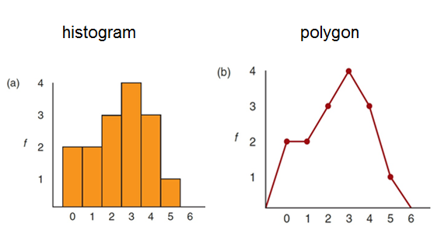
Frequency Distribution Graphs
Notes:
Figure 15.1 Frequency Distribution Graphs
The same set of scores is shown in a histogram (a) and in a polygon (b).

Slide 11
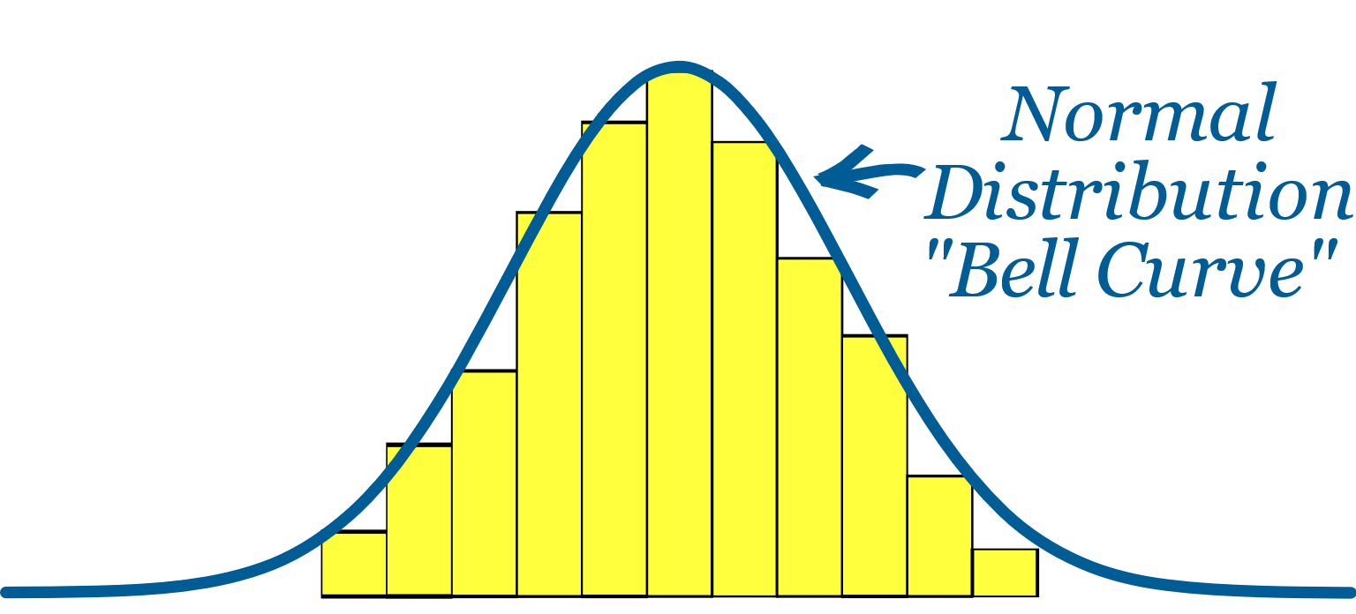
Frequency Distribution Graphs
Notes:
Figure 15.1 Frequency Distribution Graphs
The same set of scores is shown in a histogram (a) and in a polygon (b).

Slide 12
Measures of Central Tendency
Central tendency is a statistical measure.
  Identifies a single score that defines the center of a distribution
    Goal: to identify the value that is most typical or most representative of the entire group

Slide 13
Measures of Central Tendency
Mean: mathematical average of a set of scores
Median: score that divides a distribution in half
Mode: most commonly occurring score

Slide 14
Central Tendency
The following list represents the scores on a mid-term exam.
  100, 94, 88, 91, 75, 61, 93, 82, 70, 88, 71, 88
Determine the mean.
Determine the mode.
Determine the median.

Slide 15
Central Tendency
The following list represents the scores on a mid-term exam.
  100, 94, 88, 91, 75, 61, 93, 82, 70, 88, 71, 88
Determine the mean. 83.42
Determine the mode.
Determine the median.

Slide 16
Central Tendency
The following list represents the scores on a mid-term exam.
  100, 94, 88, 91, 75, 61, 93, 82, 70, 88, 71, 88
Determine the mean. 83.42
Determine the mode. 88
Determine the median.

Slide 17
Central Tendency
The following list represents the scores on a mid-term exam.
  1000, 94, 88, 91, 75, 61, 93, 82, 70, 88, 71, 88
Determine the mean. 150ish
Determine the mode. 88
Determine the median. 88

Slide 18
Central Tendency
The following list represents the scores on a mid-term exam.
  1000, 94, 88, 91, 75, 61, 93, 82, 70, 88, 71, 88
Determine the mean. 150ish
Determine the mode. 88
Determine the median. 88

Slide 19
Univariate Analysis
Dispersion – The distribution of values around some central value, such as an average.
Standard Deviation – A measure of dispersion around the mean
  Calculated so that 68% of the cases will lie within plus or minus one standard deviation from the mean, 95% within two, and 99.9% within three standard deviations.

Slide 20
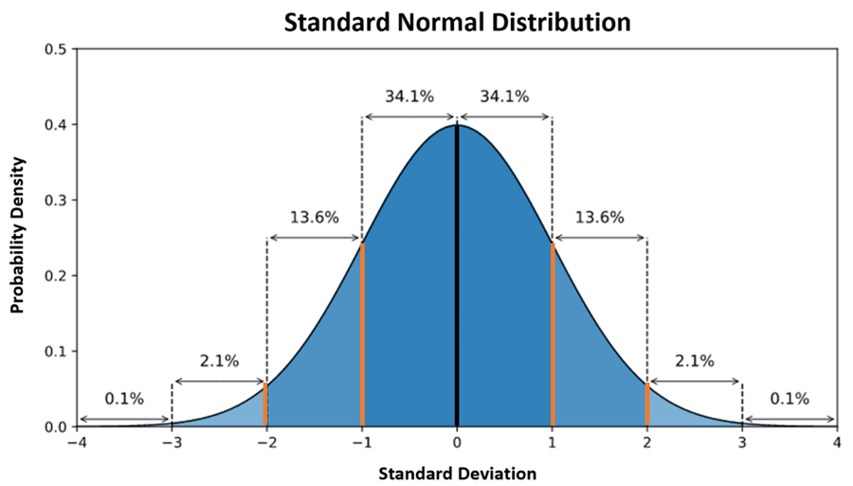
Univariate Analysis

Slide 21
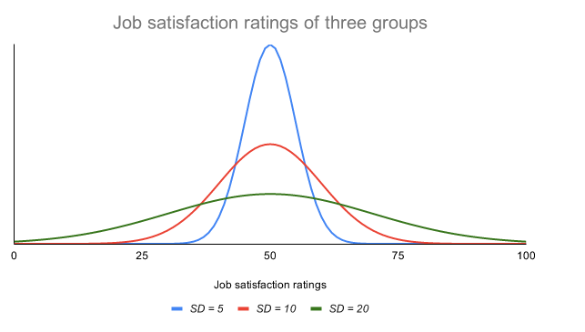
Kurtosis

Slide 22
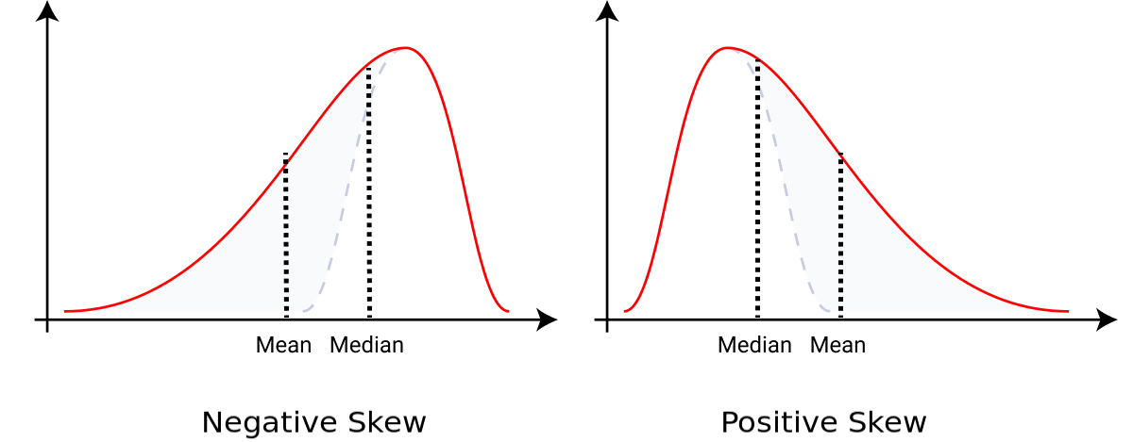
Skewed Distributions

Slide 23
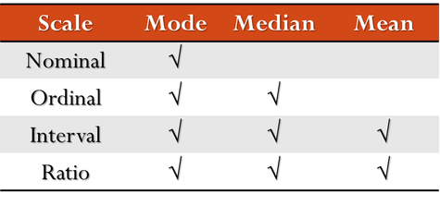
Describing Non-Numerical Data
Nominal and ordinal data can also be described using proportions and percentages

Slide 24
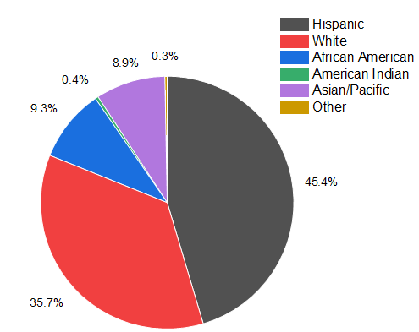
Describing Non-Numerical Data

Slide 25
Bivariate Analysis
Bivariate Analysis – The analysis of two variables simultaneously, for the purpose of determine the empirical relationship between them.
Multivariate Analysis – Same as above, but with three or more variables
Bivariate and Multivariate are often used in inferential statistics

Slide 26
Advantages of Multivariate Techniques
Multivariate techniques allow the researcher to address issues with facts
Example: Measuring multiple variables at the same time can be used to explain why women make less than men in the job market

Slide 27
Inferential Statistics
Inferential statistics addresses the issue of how accurately a sample represents a population.
  Sampling error: naturally occurring difference between a sample statistic and the population parameter

Slide 28
Inferential Statistics
  Population of 1,000 College Students
  Population Parameters
    Average age = 21.3 Years
    Average IQ = 112.5
    56% female, 44% male

Slide 29
Inferential Statistics
  Sample 1
    Eric
    David
    Laura
    Karen
    Brian
Sample Statistics
  Average age = 19.8
  Average IQ = 104.6
  40% female, 60% male
  Population Parameters
    Average age = 21.3 Years
    Average IQ = 112.5
    56% female, 44% male

Slide 30
Inferential Statistics
  Sample 2
    Stacey
    Kristen
    Sara
    Andrew
    Jessica
Sample Statistics
  Average age = 20.4
  Average IQ = 114.2
  80% female, 20% male
  Population Parameters
    Average age = 21.3 Years
    Average IQ = 112.5
    56% female, 44% male

Slide 31
Hypothesis testing
What is a hypothesis test?
  Determines whether the sample data provide convincing evidence to support the original research hypothesis
Goal of a hypothesis test
  Rule out chance as a plausible explanation for the results

Slide 32
The Five Basic Elements of a Hypothesis Test
Null hypothesis
Sample statistic
Standard error
Test statistic (t-test, F-test, etc.)
Alpha level (level of significance)

Slide 33
The Five Basic Elements of a Hypothesis Test
Null hypothesis (H₀) vs Alternative Hypothesis (H₁)
  Example Null: Hours of sleep has no effect on memory
  Example Alt: More sleep leads to better memory
Sample statistic
  Example: Mean test performance
Standard error
  Example: What is the dispersion of test scores?

Slide 34
The Five Basic Elements of a Hypothesis Test
Test statistic (z-test, t-test, F-test, etc.)
  Tells us something about our data (Example: if z > 1.96, significant)
Alpha level (level of significance)
  p-value
But what does it mean to be “significant”?

Slide 35
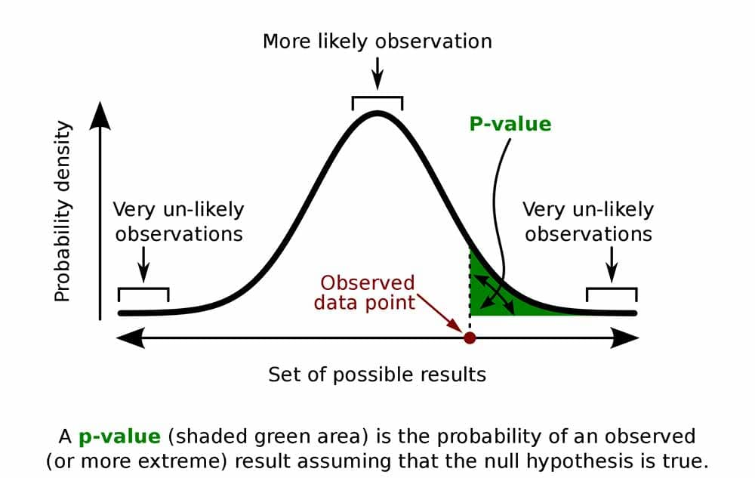
Z = 2

Slide 36
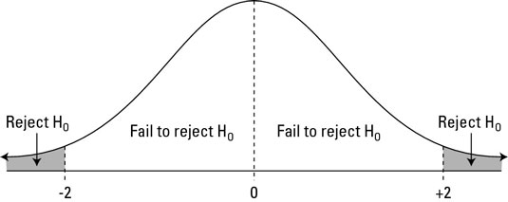
Z = 1.96

Slide 37
Errors in Hypothesis Testing
Type I error
  Researcher finds evidence for a significant result when there is actually no effect.
Type II error
  Sample data do not show evidence of a significant effect when a real effect exists in the population.
    Occurs when the effect is so small that it does not show up in the sample.

Slide 38
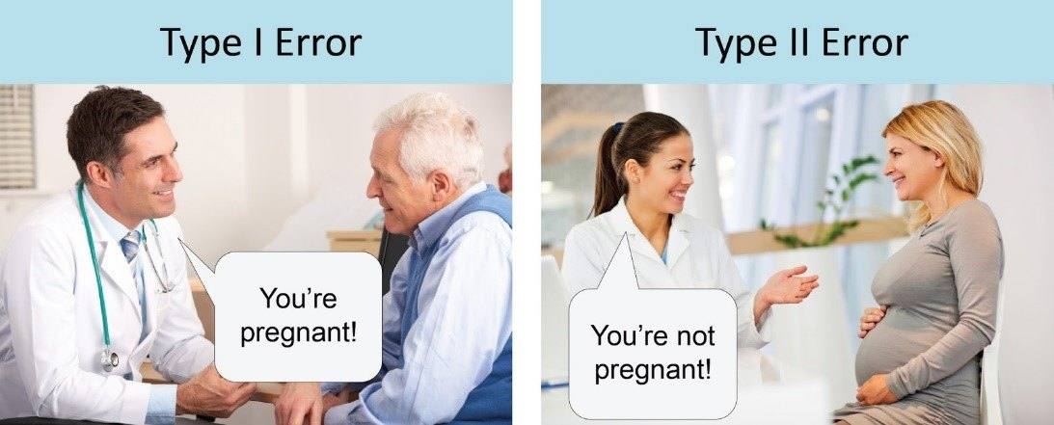

Slide 39
Factors That Influence the Outcome of a Hypothesis Test
The number of scores in the sample
  A mean difference or a correlation found with a large sample
    More likely to be significant than the same result found with a small sample
The size of the variance
  A sample mean with high variance
    Less likely to be significant than the same result found with low variance

Slide 40
Statistics for Data from Category 1
Numerical scores from interval or ratio scales
Descriptive Statistics
  Mean and Standard deviation
Inferential Statistics (If a reasonable hypothesis exists.)
Notes:
Figure 15.12 Statistics for Data from Category 1: A Single Group of Participants with One Score per Participant
The goal is usually to describe the variable as it exists naturally.

Slide 41
Statistics for Data from Category 1
Nominal scores (named categories) Mode
Proportions or percentages to describe the distribution across categories
  Chi-square test for goodness of fit
    Use the sample frequencies to test a hypothesis about the proportions in the population
Notes:
Figure 15.12 Statistics for Data from Category 1: A Single Group of Participants with One Score per Participant
The goal is usually to describe the variable as it exists naturally.

Slide 42
Statistics for Data from Category 2
The goal of analyzing data in this category
  To describe and evaluate the relationships between variables, typically two variables at a time
The most commonly used statistics are correlation and regression.
Notes:
Figure 15.12 Statistics for Data from Category 1: A Single Group of Participants with One Score per Participant
The goal is usually to describe the variable as it exists naturally.

Slide 43
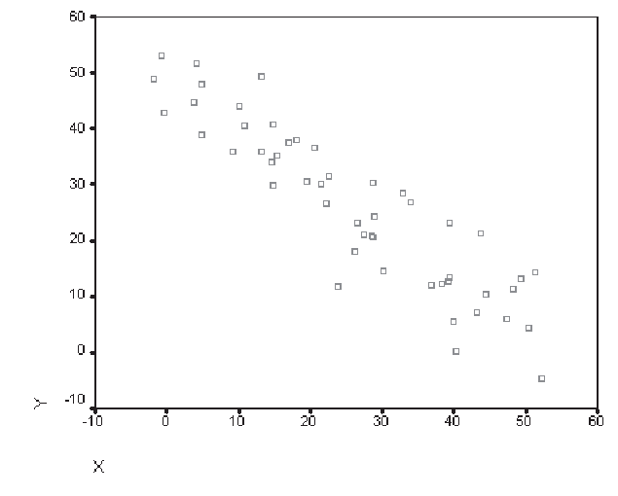
Correlations

Slide 44
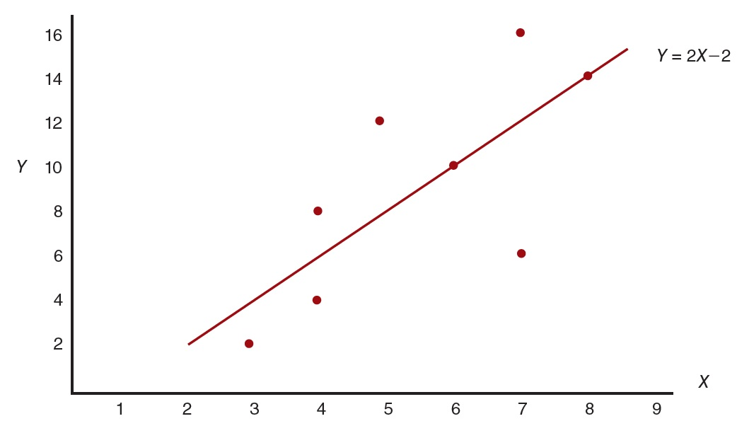
Regression
The statistical process of finding the linear equation
  Produces the most accurate predicted values for Y using one predictor variable (X)

Slide 45
Statistics for Data from Category 3
Analysis methods:
  Numerical scores ► one-way ANOVA and t-tests (independent or repeated measures)
  Nominal or ordinal scales ► chi-square test for independence
  Two-factor designs with interval or ratio scales ► two-way ANOVA

Slide 46
Finding the Right Statistics for Your Data
When to use each type:
  Category 1: descriptive research strategy
      one group of participants; one variable measured per participant
  Category 2: correlational research strategy
      one group of participants; two (or more) variables measured for each participant
  Category 3: experimental, nonexperimental, and quasi-experimental research strategies
      two or more groups of scores with each score a measurement of the same variable

Slide 47
Ethics and Quantitative Data Analysis
Unbiased analysis and reporting is an ethical concern for quantitative analysis as well as in qualitative analysis.
Don’t fake your data!!
The privacy of subjects must be protected in analysis and reporting.

